Slide 1
Naruto Face GAN
Noah Buchanan

Slide 2
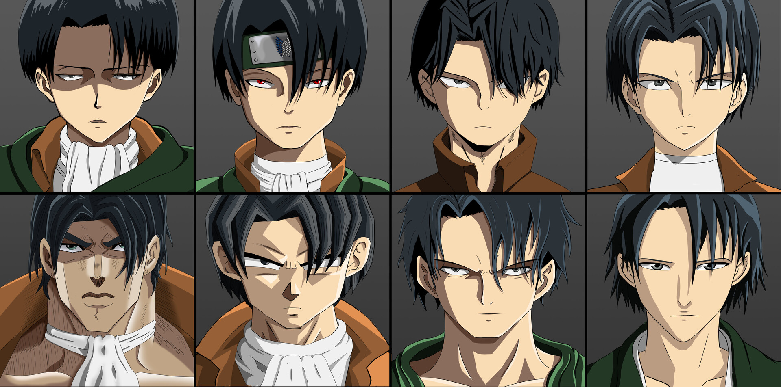
Goal of the project
Create a Deep Convolutional Generative Adversarial Network that could mimic the art style of popular animes and generate new unseen characters in that art style.
[1]

Slide 3
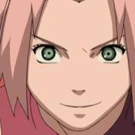
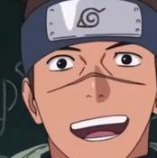
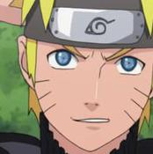
Training Data
3838 pictures
Images are resized to 64x64
Scaled 0 - 1
Data was shuffled randomly
Multiple pictures of the same character were included back to back repeatedly

Slide 4
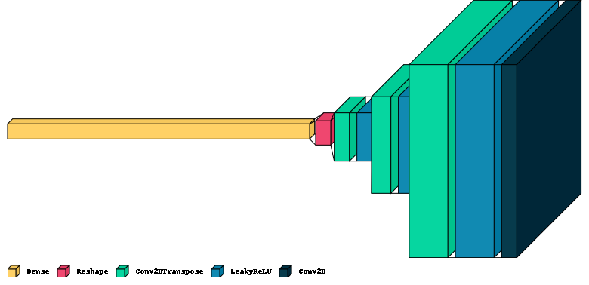
Model Architecture
Generator
~4 million parameters

Slide 5
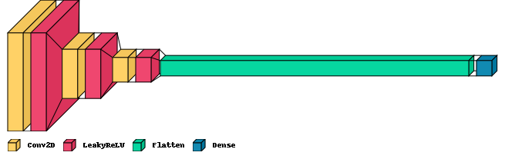
Model Architecture
Discriminator
~400,000 parameters

Slide 6
Model Details
Leaky ReLU used throughout to prevent vanishing gradient when training
Binary Cross Entropy loss
Adam Optimizer with a learning rate of 0.0001 for both generator and discriminator

Slide 7






Generated Characters

Slide 8




Examples of when it goes wrong

Slide 9
Future Work
Dataset was quite limited
Low variance of characters
Small amount of images for training
Larger architecture with 128 x 128 output resolution
Training time was effectively cut short

Slide 10

Questions?

Slide 11
References
https://www.artstation.com/artwork/g2DQ3P [1]

